Slide 1


Helper Classes
Kristine Middlemiss, Senior Developer Consultant
Autodesk Developer Network (ADN)
© 2012 Autodesk
1

Slide 2

Agenda
• API Command Utilities
• Error Handling and Debugging
• DAG Hierarchy
© 2012 Autodesk
2

Slide 3
API Command Utilities
© 2012 Autodesk
3

Slide 4
Utilities API: MGlobal
• Query and set global settings (time, z-up, selection
masks, etc..)
• Query what is selected or highlighted
• Display command warnings and errors
• Interaction with script languages
© 2012 Autodesk
4

Slide 5
Utilities API: MGlobal
• Query and set global settings (time, z-up, selection masks,
etc..)
•
•
•
•
•
MGlobal::mayaState(MStatus * returnStatus)
MGlobal::viewFrame ( const MTime & time )
MGlobal::setSelectionMode ( MGlobal::MSelectionMode mode)
MGlobal::setYAxisUp (bool rotateView)
Etc…
© 2012 Autodesk
5

Slide 6
MGlobal & Selection List
• MSelectionList: class representing a list of MObjects
• Used for more than just what is selected, e.g.
• Highlight list
• Query / Modify list membership
• MItSelectionList:class for iterating over the items in an
MSelectionList. A filter can be specified so that only those
items of interest on a selection list can be obtained.
MGlobal::getActiveSelectionList(MSelectionList &dest);
MGlobal::getSelectionListByName ( const MString & name, MSelectionList & list )
MGlobal::setActiveSelectionList( const MSelectionList & src,
MGlobal::ListAdjustment )
© 2012 Autodesk
6

Slide 7
MGlobal Selection
•
•
•
•
•
MGlobal::select ( const MDagPath & object, MGlobal::ListAdjustment listAdjustment )
add an object to the active selection list without creating an MSelectionList first
MGlobal::selectByName(const MString & name, MGlobal::ListAdjustment listAdjustment )
finds all objects matching a pattern and adds them to the active selection list
MGlobal::setActiveSelectionList ( const MSelectionList & src, MGlobal::ListAdjustment )
Set the active selection list. The selection items on the given list will update the contents
of the active selection list as indicated by the listAdjustment parameter.
MGlobal::selectCommand ( const MSelectionList & src, MGlobal::ListAdjustment )
Set the active selection list, by calling the built in Maya select command
MStatus MGlobal::selectFromScreen ( const short & x_pos, const short & y_pos,
MGlobal::ListAdjustment, MGlobal::SelectionMethod )
Perform click-pick type selection. If an object intersects the click point then it is
selected according to listAdjustment.
© 2012 Autodesk
7

Slide 8
Utilities API: MGlobal
• Display error/warning messages or general information to
the user for custom command
void MGlobal::displayInfo ( const MString & theMessage )
void MGlobal::displayWarning ( const MString & theWarning )
void MGlobal::displayError ( const MString & theError )
© 2012 Autodesk
8

Slide 9
Utilities API: MGlobal
• Execute MEL script:
MGlobal::executeCommand(const MString &command)
MGlobal::sourceFile
• Execute Python Command:
MGlobal::executePythonCommand (const MString &command)
# execute MEL command to create a nurbs sphere
OpenMaya.Mglobal.executeCommand( "sphere" );
# execute the specified mel script
OpenMaya.MGlobal.sourceFile( "C:\\MyScripts\\testScript.mel" );
#execute python command to create a poly cube
OpenMaya.MGlobal.executePythonCommand (“polyCube( sx=10, sy=15, sz=5, h=20 )”)
© 2012 Autodesk
9

Slide 10
Error Handling and Debugging
© 2012 Autodesk
10

Slide 11
Error checking: MStatus
• We have removed the MStatus class.
• Python exceptions (try and except) must be used instead
of MStatus.
• 3 Special cases:
▪
Hardcoded Maya API class for status codes:
OpenMaya.MStatus.kSuccess - The operation was successful
OpenMaya.MStatus.kFailure - The operation failed
OpenMaya.MStatus.kUnknownParameter - Returned by
MPxNode::compute for unrecognized plugs
© 2012 Autodesk
11

Slide 12

OpenMaya Status Codes
• Python API does not contain MStatus
• Any method that would have returned a non-success
• MStatus will raise an exception instead
• Provides error checking that is more natural in Python
try:
except:
© 2012 Autodesk
mplugin.registerNode( kPluginNodeTypeName, sineNodeId,
nodeCreator, nodeInitializer )
sys.stderr.write( "Failed to register node: %s" %
kPluginNodeTypeName )
raise
12

Slide 13
DAG Hierarchy
© 2012 Autodesk
13

Slide 14
DAG (Directed Acyclic Graph)
• DAG Nodes are just DG Nodes!
• Parenting are not dependency graph connections
• DAG hierarchy
• Node types containing transformation info:
• joints (MFn::kJoint)
• transforms (MFn::kTransform)
• Other typical node types in a skeletal hierarchy:
• shapes (nurbs, polys, …)
• locators (MFn::kLocator)
• Ik (MFn::ikHandle, MFn::ikEffector)
© 2012 Autodesk
14

Slide 15
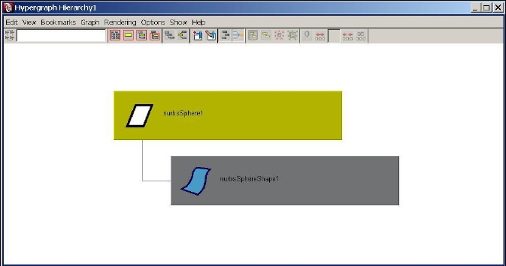
DAG Hierarchy
• An Example: sphere
© 2012 Autodesk
15

Slide 16
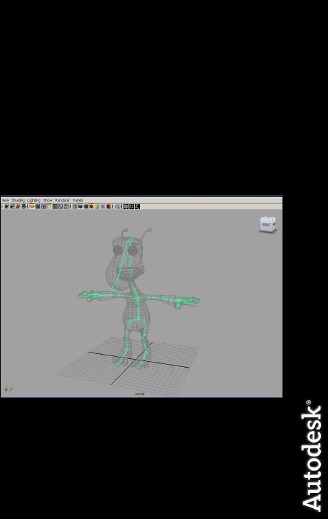
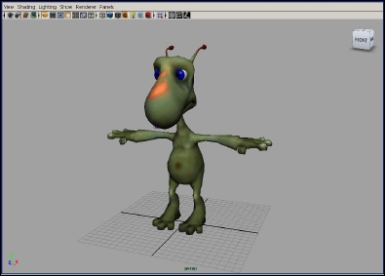
DAG Hierarchy
• A more complex example: skeleton hierarchy
© 2012 Autodesk
16

Slide 17
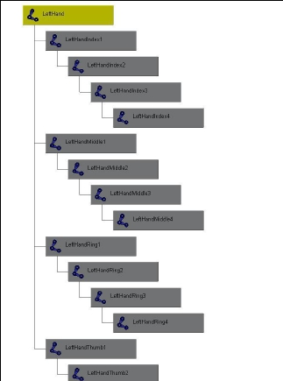
DAG Hierarchy
• A more complex example: skeleton hierarchy
hip
spine
shoulder
arm
hand
© 2012 Autodesk
17

Slide 18
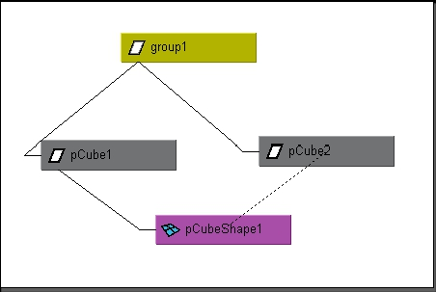
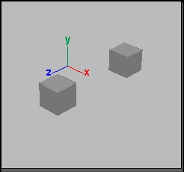
Instancing
• A node may have more than one parent
• A dagPath is used to identify instances
group1|pCube1|pCubeShape1
group1|pCube2|pCubeShape1
© 2012 Autodesk
18

Slide 19
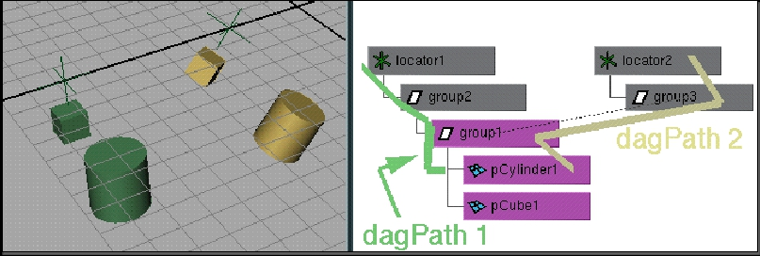
Dag Paths
• used to find world space transformations
• used to traverse up and down hierarchy
• node names need not be unique if dagPaths are different
(MDagPath fullPathName, partialPathName)
© 2012 Autodesk
19

Slide 20
MObject VS. MDagPath
Many of the Maya API accept/return a MObject or a
MDagPath
• A MDagPath is a handle describing a path to a node
• A MObject is a wrapper around a pointer to the internal Maya object
• Generic class (represents all node / attribute)
• Use apiType() / hasFn() to determine what it is or what you can do
with it
• Use isNull() to determine if it is a valid MObject
• Do not store MObject
© 2012 Autodesk
20

Slide 21
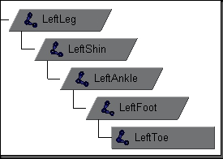
Important API methods
• Traversal : MItDag iterator class
• Depth in hierarchy: MDagPath::length, MItDag::depth
• Getting the parent: MDagPath::pop
• Local matrix: MFnTransform::transformation
• World matrix: MDagPath::inclusiveMatrix,
MDagPath::exclusiveMatrix …
© 2012 Autodesk
21

Slide 22
Workshop Session
© 2012 Autodesk
22

Slide 23
Example: dagInfo
• In this exercise, we will implement a custom command
dagInfo. For all the selected DAG nodes in the scene, it
will print out the instance information, dag path and also
inclusive and exclusive matrix.
• Important Classes: MFnDagNode, MDagPath MMatrix,
MGlobal, MItSelectionList
© 2012 Autodesk
23

Slide 24
Autodesk
© 2012 Autodesk
24

